Slide 1
A core Course on Modeling
Introduction to Modeling
0LAB0 0LBB0 0LCB0 0LDB0
c.w.a.m.v.overveld@tue.nl
v.a.j.borghuis@tue.nl
P.14

Slide 2
Structural and quantitative confidence in the lantern model.
Contents
Scaffolding
Correct qualitative behavior
Varying cat.-I quantities
Plotting graphs using the analysis tab
Correct asymptotic behavior
Correct singularities
Convergence

Slide 3
Scaffolding.
Build extra features in the model, not needed for the calculation of the cat.-II quantities, but to inspect the validity of the model.
Lanterns:
brightness distribution over the road
difference between max and min intensity
try!
try!

Slide 4
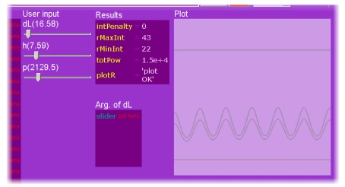
Scaffolding.
Build extra features in the model, not needed for the calculation of the cat.-II quantities, but to inspect the validity of the model.
Lanterns:
brightness distribution over the road
difference between max and min intensity
try!
try!

Slide 5
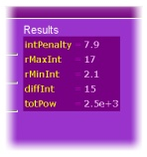
Scaffolding.
Build extra features in the model, not needed for the calculation of the cat.-II quantities, but to inspect the validity of the model.
Lanterns:
brightness distribution over the road
difference between max and min intensity
try!
try!

Slide 6
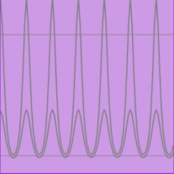
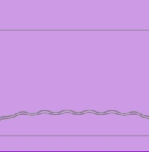
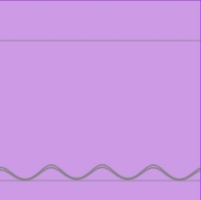
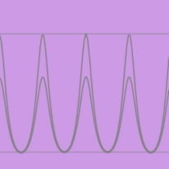
Correct qualitative behavior.
Varying cat.-I quantities. Examples:
dL=25 m; h=5.5 m; p ≅ 2.4 kW
dL=25 m; h=12 m; p ≅ 2.4 kW: higher lanterns, so less fluctuations
dL=15 m; h=12 m; p ≅ 2.4 kW: lanterns closer together: very little fluctuations
dL=15 m; h=3 m; p ≅ 1 kW: shorter lanterns, so less energy/m
( 1/15 < 2.4/25) – but more fluctuations

Slide 7
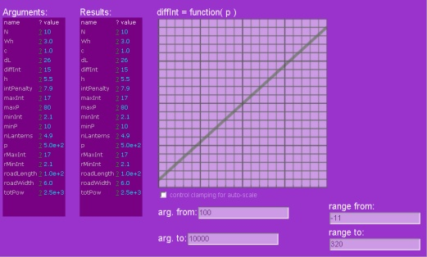
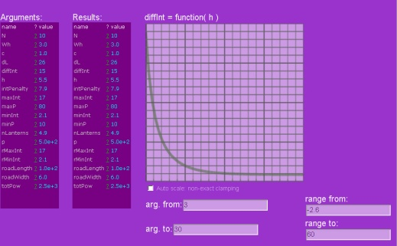
Correct qualitative behavior.
Plotting graphs using the analysis-tab. Examples:
Both maxInt and minInt are proportional to P.
So their difference also
should be proportional to p.
Taller lanterns cause more blending → less fluctuations
Lanterns further apart give larger fluctuations, so larger difference between maxInt and minInt.

Slide 8
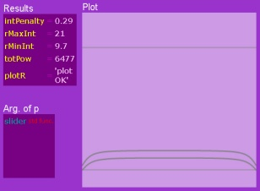
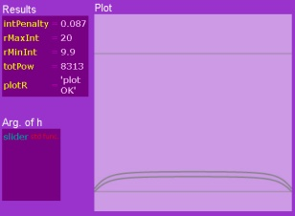
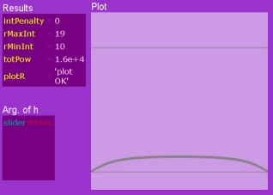
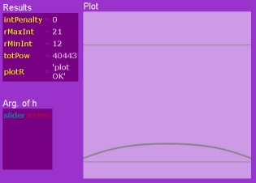
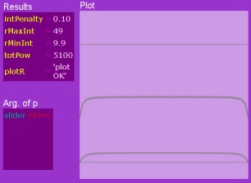
Correct asymptotic behavior.
If the street is long enough (100m) compared to the height of the lanterns (2 ... 32 m) we expect to see the boundary effects separated from the regular behavior:
h=2 m
flat region?
h=4 m
hardly any flat region
flat region
h=8 m
flat region
flat region
h=16 m
h=32 m

Slide 9
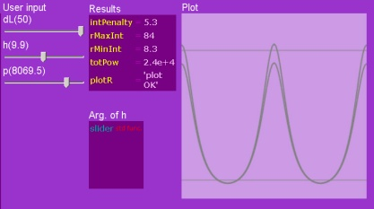
Correct singularities.
If dL is very large compared to h, we can ignore adding contributions of multiple lanterns.
The maximum intensity can then be calculated as p/h²:
p = 8069.5 W
h = 9.9 m
p/h² = 82.3 W/m²
ACCEL gives 84 W/m².
OK because of
contribution of
other lanterns.

Slide 10
Correct convergence.
Suppose we increase performance by taking fewer lanterns into account.
allows to set # lanterns to taken into account.
This version of the model

Slide 11
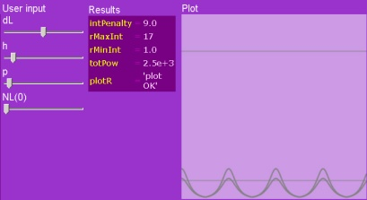
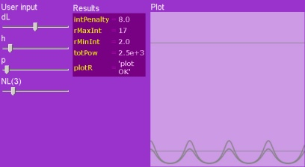
Correct convergence.
Suppose we increase performance by taking fewer lanterns into account.
How few lanterns is enough for reliable result → depends on regime
dL=25 m; nr. neighbours = 0
dL=25 m; nr. neighbours = 2
dL=25 m; nr. neighbours = 3 → no noticeable difference, so left and right 2 lanterns is enough.

Slide 12
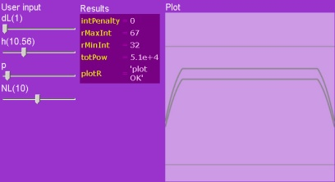
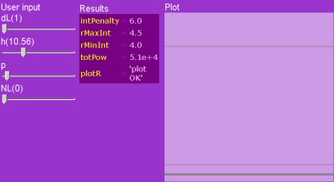
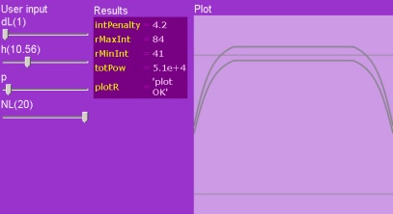
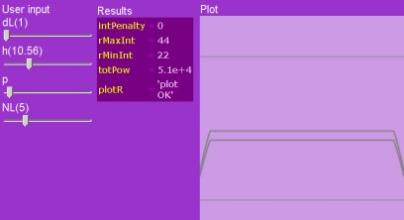
Correct convergence.
Suppose we increase performance by taking fewer lanterns into account.
How few lanterns is enough for reliable result → depends on regime
dL=1 m; nr. neighbours = 0
dL=1 m; nr. neighbours = 5
dL=1 m; nr. neighbours = 10
dL=1 m; nr. neighbours = 20: graph still looks not smooth, we presumably need more lanterns.

Slide 13
Summary:
Scaffolding may be useful to help ascertain the convincingness of the model;
Qualitative behavor: think of configurations that can easily be understood;
Asymptotic behavior: can we separate ‘boundary effects’ that can be ‘reasoned away’;
Singular behavior: are there cases where we can do the math even without a computer;
Convergence: do we take enough terms, steps, ... .

